Slide 1
Index:
Project Title: E- Auction Management System
Group Number: 08
Name: Riya Dhorajiya - 202206100110058
Krish Virani - 202206100110142
Hemil Ghori - 202206100110147
Isha Jivani - 202206100110212
Guide Name: Ms. Kajal Patil (Assistant Professor)
Institute Details: Babu Madhav Institute of Information Technology, UTU.
Semester: 5th Semester, Integrated M.Sc. (IT).

Slide 2
Introduction:
Project Definition: The E-Auction Management System is an online platform designed to facilitate auctions between sellers and bidders. The system operates within the scope of e-commerce, specifically catering to antique items. Sellers can list items, bidders can participate in auctions, and admins can verify item, ensuring smooth transactions and auction management. The product aims to automate the entire auction process, from listing items to managing payments and refunds. It will connecting buyers and sellers across India. Users access the system through their web browsers.

Slide 3
Introduction(conti…):
Project Purpose: The purpose of the E-Auction Management System is to provide a platform for all sellers of antique items to auction online. The system will facilitate the auctioning process, allow users to bid on various antiques while ensuring a smooth, secure, and user-friendly experience.
Project Scope: Our scope of the System shall be within all over the india to connect sellers to bidder for antique item auction.

Slide 4
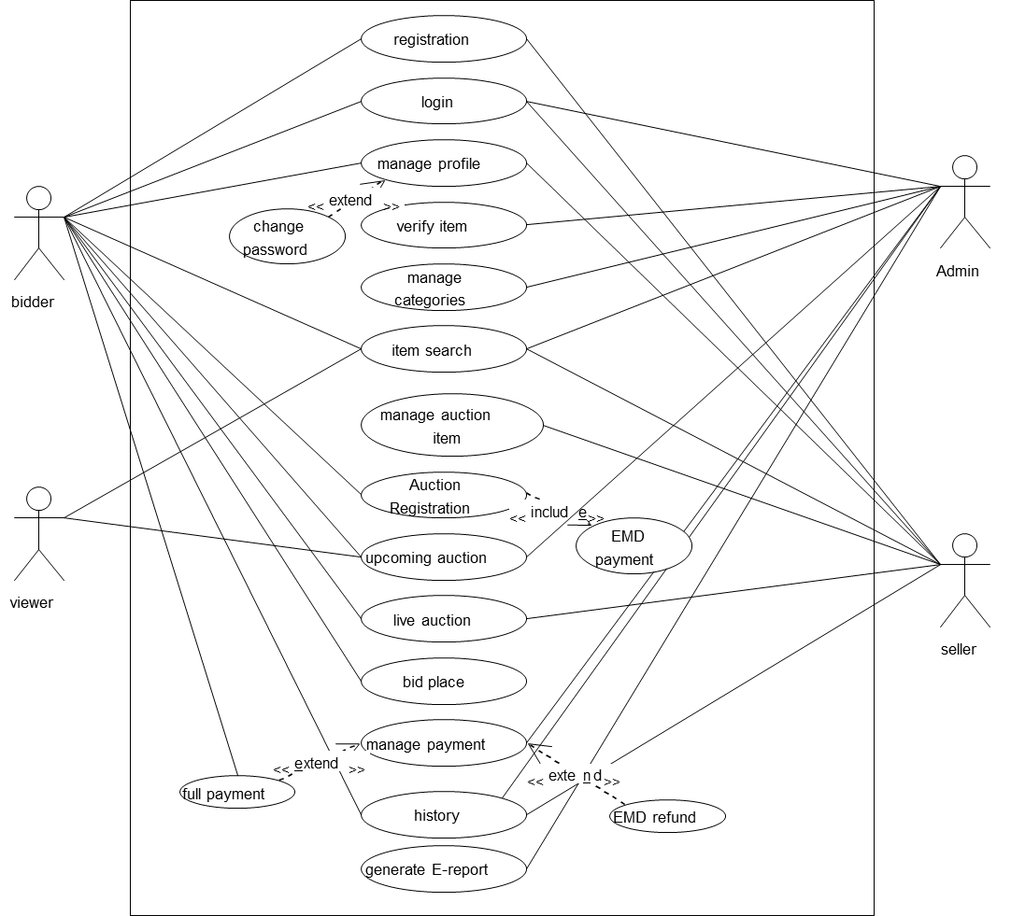
UML Diagram :
1. Use Case Diagram

Slide 5
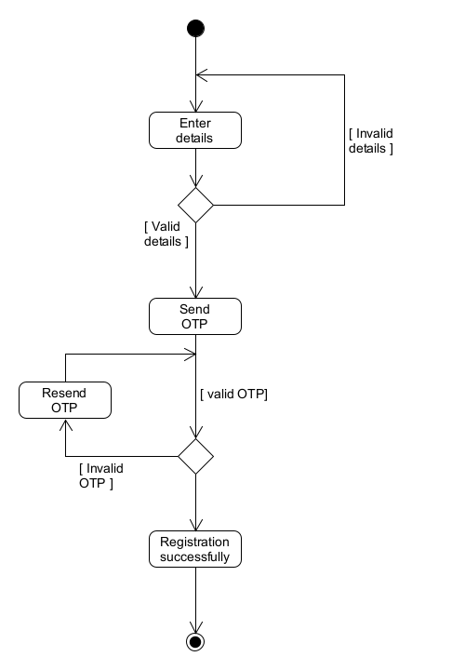
UML Diagram(conti…):
2. Activity Diagram
Registration:

Slide 6
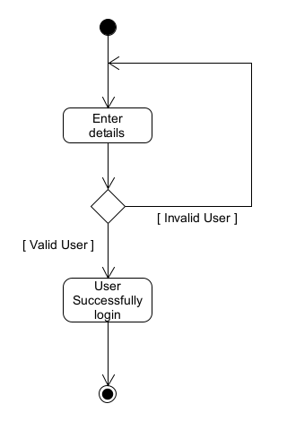
UML Diagram(conti…):
2. Activity Diagram
Login:

Slide 7
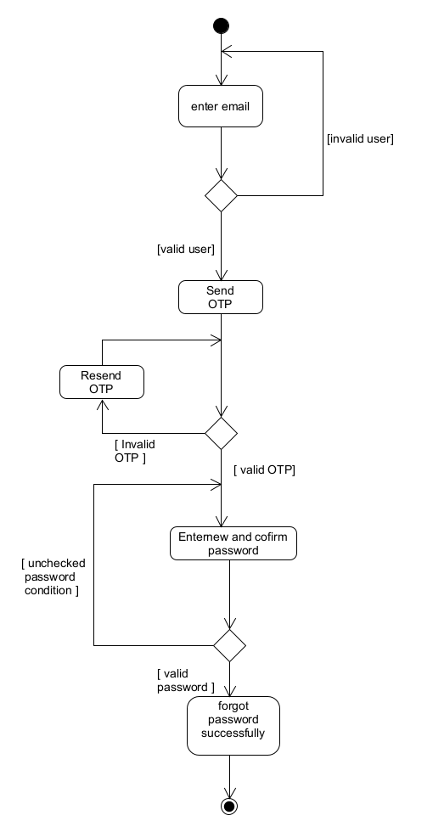
UML Diagram(conti…):
2. Activity Diagram
Forget Password:

Slide 8
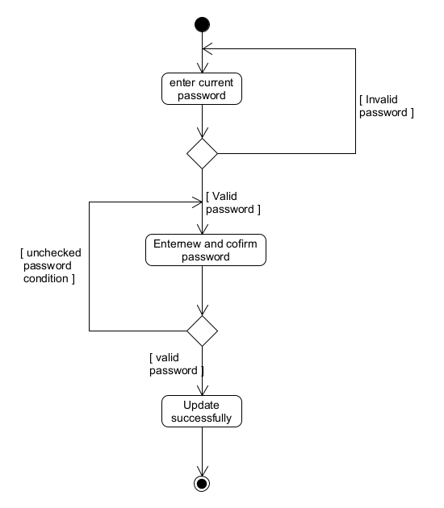
UML Diagram(conti…):
2. Activity Diagram
Change Password:

Slide 9
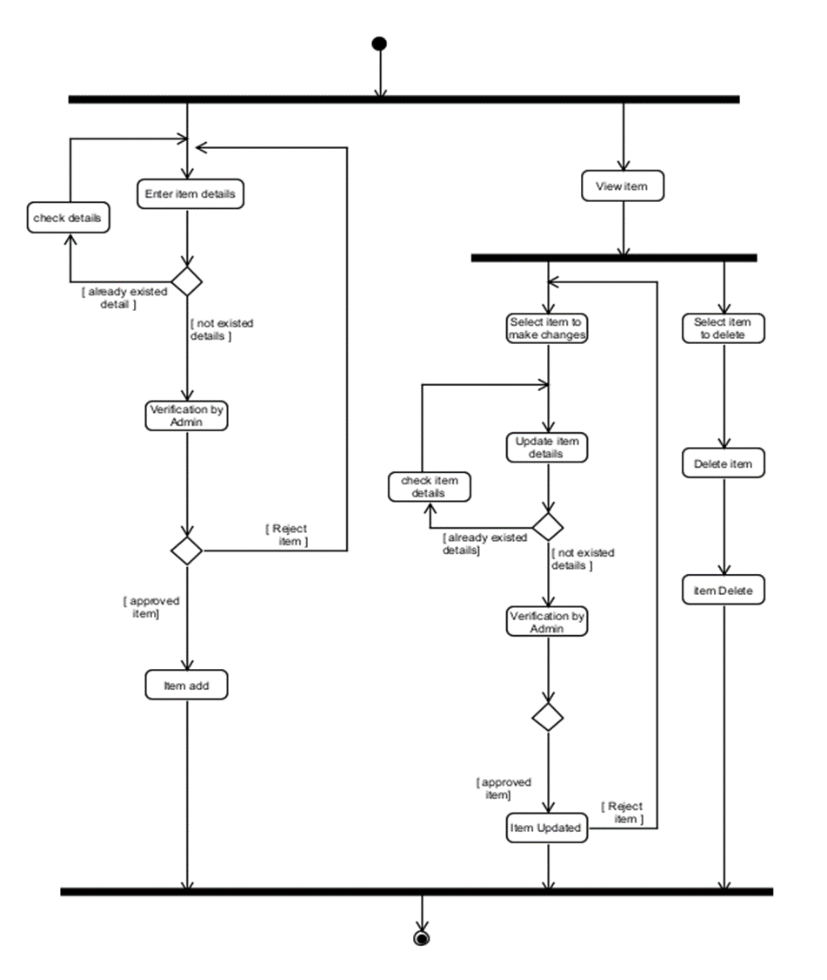
UML Diagram(conti…):
2. Activity Diagram
Manage Item:

Slide 10
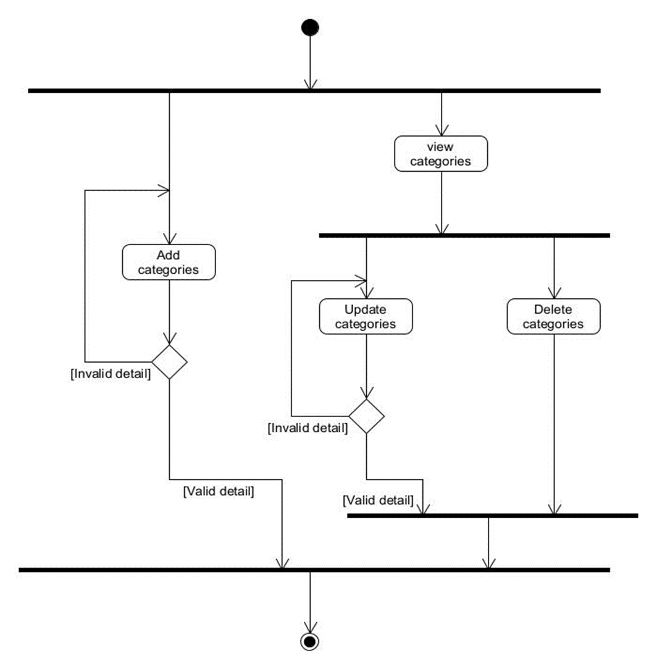
UML Diagram(conti…):
2. Activity Diagram
Manage Categories:

Slide 11
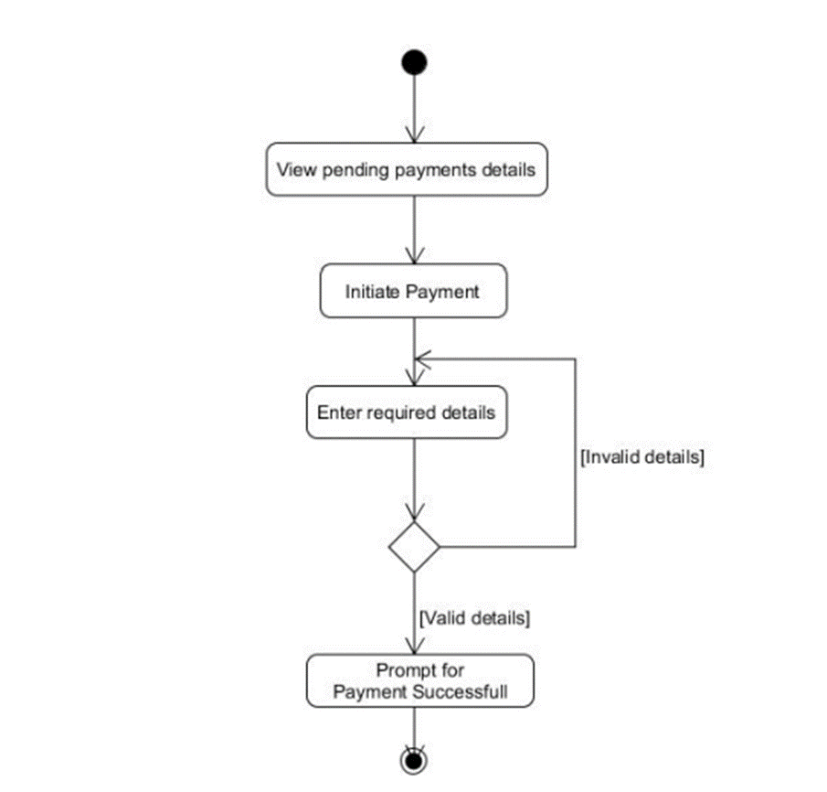
UML Diagram(conti…):
2. Activity Diagram
Payment:

Slide 12
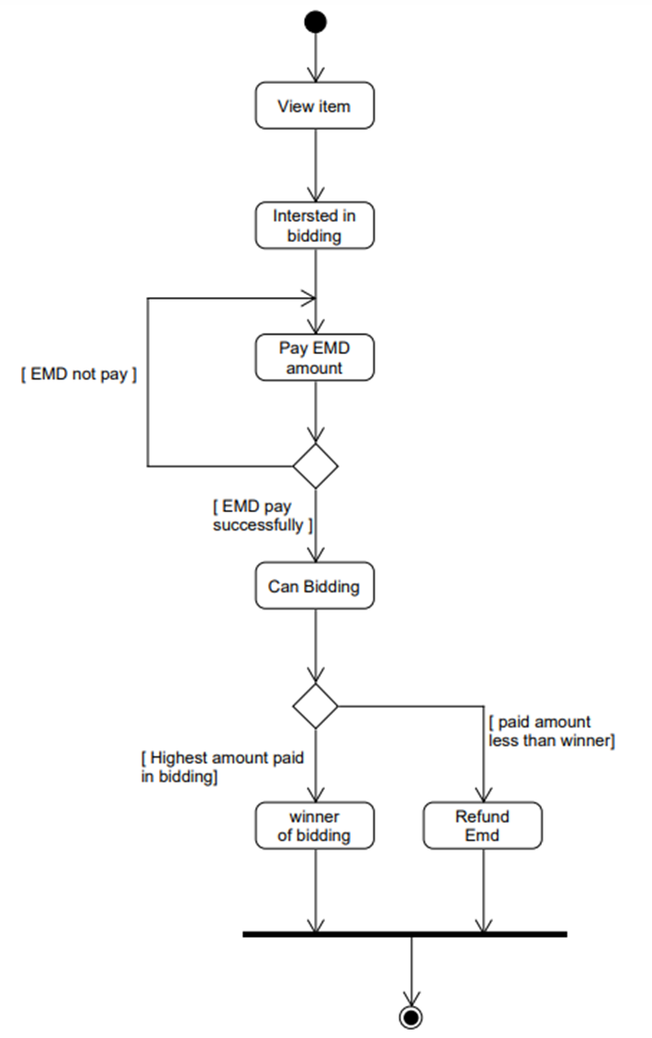
UML Diagram(conti…):
2. Activity Diagram
Bidding:

Slide 13
Thank
You

